Slide 1




Slide 2

EMOTIONAL INTELLIGENCE
SKILL TEST

Slide 3

CONCEPTS
What Is A Skills Test?
Notes:
A skills test is an assessment test used to evaluate the skills and abilities of job candidates. These tests are designed to determine if a job applicant has the necessary skills to perform the various aspects of a job. In some cases, employers may even ask their existing employees to take this test. Primarily, however, a skills assessment test happens during the hiring process, where questions are designed as per the responsibilities to be performed in the open job position. The primary purpose of using these tests is to shortlist the right candidates for a job interview.

Slide 4
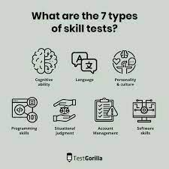
CONCEPTS
Types Of Skill Tests
Notes:
Companies conduct these tests for multiple reasons. Here are some of the different types of skills assessment tests used during the recruitment process:

Slide 5

CONCEPTS
Hard skills assessment
Notes:
A hard skills assessment test is used to evaluate a candidate's skills in a particular area, such as statistics, software development, accounting and typing. The result provides information about the proficiency of the candidate in a particular skill. Employers decide what skill proficiency level is required for the job position and shortlist candidates accordingly.

Slide 6
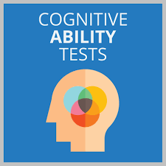
CONCEPTS
Cognitive ability test
Notes:
Instead of measuring how applicants would perform in expected, everyday situations, cognitive ability tests assess how candidates would perform in more unexpected scenarios. They do this by evaluating a person's ability to think abstractly when using numerical and verbal reasoning skills. Often, game-based assessments are used to measure cognitive ability. This format is more approachable for the candidate, and the process is typically much faster than the more traditional cognitive skill tests.

Slide 7
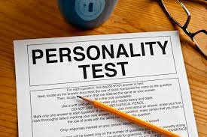
CONCEPTS
Personality test
Notes:
This type of test helps assess a candidate's interests, preferences and motivation. Employers typically conduct this test when hiring someone for a role that requires a particular demeanour. For instance, an introverted person can be a good fit for a role that requires a lot of active listening, such as a counsellor.

Slide 8
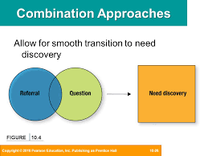
CONCEPTS
Combination approach
Notes:
Many organisations choose to combine several assessment tests rather than utilise just one. This provides more comprehensive results that will eliminate the weaknesses of using only one assessment. However, this approach takes more of the candidate's time.

Slide 9

CONCEPTS
Psychometric test
Notes:
A psychometric test is an assessment done to evaluate a candidate's behavioural style and mental ability. This test helps to understand the candidate's suitability for an open job position by matching their aptitude and personality traits with those needed to perform the job. This type of test is often conducted online. This way, the employer can easily collect and analyse the results of the test to identify the candidate's behavioural characteristics, which is difficult to analyse in a face-to-face interview.

Slide 10
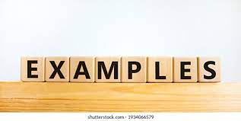
CONCEPTS
Examples Of Skill
Assessment Tests
Notes:
Here are a few examples of tests employers use to assess the skills of candidates:

Slide 11
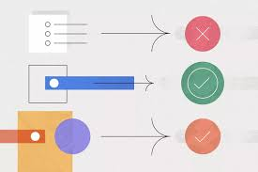
CONCEPTS
Question-Answer Test
Notes:
This test helps to assess if the candidate has knowledge of key areas required for the job. For example, a newspaper looking for an editor may need candidates to sit an English test with multiple choice questions on grammar, spelling, sentence constructions. The newspaper company may rank candidates based on the number of correct answers given by the candidates.

Slide 12
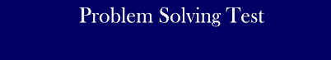
CONCEPTS
Problem-solving test
Notes:
A problem-solving test states a few problems, and candidates have to provide solutions to them. For example, for a software developer role, you may be asked to find bugs in the given code and make it error-free. The evaluator would judge your skills based on whether you could find a solution to the problem and the efficiency of the solution.

Slide 13
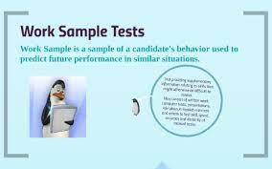
CONCEPTS
Work sample test
Notes:
In a work sample test, a candidate typically needs to submit a piece of work that is similar to the type of work they will perform if hired. For example, for a content writing position, you may need to write and submit a sample article on a given topic. The employer will then evaluate your work on some set parameters like grammar, vocabulary and the ability to capture the right voice.

Slide 14

CONCEPTS
Role-playing test
Notes:
In a role-playing test, the interviewer may present you with a scenario and ask you to respond as you would in the role. For example, one of the interviewers might act as an angry customer and ask you to show you how would tackle a customer complaint. The evaluator would evaluate you on how efficiently you handled the situation while maintaining respect for the customer.

Slide 15

CONCEPTS
What Is In A Basic Skill Test?
Notes:
A basic skill test typically assesses the basic maths and verbal skills of a candidate. Employers often conduct this test to shortlist candidates for entry-level positions. Here are two examples of basic skills tests:

Slide 16
CONCEPTS
Criteria Basic Skills Test (CBST): This test aims to evaluate a candidate's verbal and mathematical skills. The test covers questions on grammar, spellings, language and maths. It is designed to evaluate your learning ability and attention to detail.
Wonderlic Basic Skills Test (WBST): This test evaluates a candidate's cognitive skills. It comprises questions on language and quantitative problems. The test is designed to assess your ability to understand instructions, learn, adapt and solve problems.

Slide 17

CONCEPTS
Top 10 Strategies For Taking Skills Assessment Tests
Notes:
Here are a few strategies and best practices for performing well in skills assessment tests:

Slide 18

CONCEPTS
Do enough research
Notes:
Many companies inform in advance what type of test they will conduct. Once you know the type of test you have to sit, do your research to know what to expect from such a test. This may include what type of questions are asked and how the tests are evaluated. This should help you prepare well and feel more confident during the test.

Slide 19
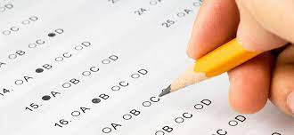
CONCEPTS
Take practice tests
Notes:
Check if the company you are interviewing for have some practice tests. Otherwise, you can find some free practice tests online. Practising will familiarise you with the test pattern and the types of questions you can expect.

Slide 20

CONCEPTS
Arrange necessary materials
Notes:
Prepare a list of essential items you will need during the test. For instance, you may want to carry pens and pencils. If you are expecting math questions, you should carry scrap paper and a pencil so that you can work on the questions quickly.

Slide 21

CONCEPTS
Take care of yourself
Notes:
Before appearing for the test, take care of your health. Get enough sleep the night before your test, eat nutritious foods and keep yourself hydrated. This will help you focus and perform well during the test.

Slide 22

CONCEPTS
Plan enough time for preparation
Notes:
You may need some time to prepare everything before taking the test. If you are taking the test from home, check your laptop and Wi-fi connection to avoid the last-minute rush. If you are taking the test at a centre, make sure you reach the centre well before time.

Slide 23

CONCEPTS
Read instructions thoroughly
Notes:
When reading the instructions, pay special attention to the time limit for each section. It will help you assign enough time to each section. During the test, you may have to refer back to the instructions and read them again.

Slide 24

CONCEPTS
Ask for clarification
Notes:
If you have a query about the instructions, simply ask the interviewer for clarification. This way, you can avoid making unnecessary assumptions and be sure that you are addressing each question correctly. Also, most employers will appreciate you for asking questions.

Slide 25

CONCEPTS
Stay calm
Notes:
Nervousness can impact your performance. Try to stay calm and focused while attempting the test questions. To calm yourself down, take a few deep breaths, drink water and trust your preparation. This will help you to stay focused and give your best in the test.

Slide 26
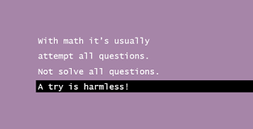
CONCEPTS
Attempt all questions
Notes:
Unless there is negative marking for wrong answers, try to give answers to all the questions. It will help you fetch more marks. If there is partial marking, you may get some marks for partially correct answers. Also, in multiple-choice questions, you can even guess the right answer.

Slide 27

CONCEPTS
Ask for feedback
Notes:
After your test results are out, ask for feedback. This will help you identify areas you need to focus on. Try to improve your skills to do better next time.

Slide 28

CONCEPTS
What Is A Skill Test In An Interview?
Notes:
A skill test in an interview is basically a skills assessment test that aims to evaluate how suitable you are for the job. Employers often assess your hard and soft skills during an interview. Interviews are flexible and often used independently or as a supplement for other assessment tests. There are two primary categories for an interview:

Slide 29

CONCEPTS
Structured
Notes:
In structured interviews, employers usually ask all candidates some predetermined questions in a precise order. This helps to maintain objectivity and reduce biases in the interview process. During the interview, the interviewer monitors your attitude and analyses your past behaviours to predict your future performance.

Slide 30
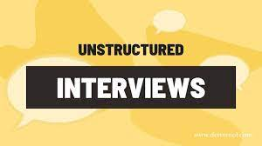
CONCEPTS
Unstructured
Notes:
Sometimes referred to as a non-directive interview, an unstructured interview is the complete opposite of a structured interview. Instead of posing predetermined questions, the interviewers may try to build a relationship and rapport with you. They may record the interview to analyse your responses later.

Slide 31
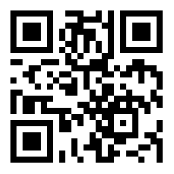
https://learn.codemithra.com

Slide 32




THANK YOU
+91 78150 95095
codemithra@ethnus.com
www.codemithra.com

